Slide 1
Gratitude
is a
Game Changer
Erin C. Mahoney
Clinical Mental Health Graduate Student
International Speaker & Author
EFT Tapping Practitioner, USAF Veteran

Slide 2
Understanding Gratitude
Creating a Gratitude Practice
Perspective
Balancing Gratitude & Realism
CHANGE THE GAME NOW!

Slide 3
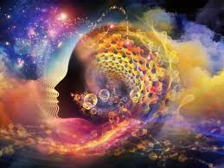
Understanding Gratitude
Gratitude is more than just saying "thank you”. It’s a deeply rooted emotional and cognitive process that enhances well-being, strengthens relationships, and shifts our perspective toward appreciation rather than lack.
Understanding gratitude involves exploring its psychological, neurological, and social dimensions.

Slide 4
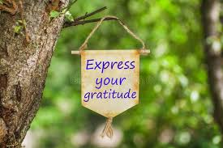
Creating a Gratitude Practice
A gratitude practice can be a simple yet POWERFUL way to improve mental well-being, increase resilience, and foster a positive outlook on life.

Slide 5
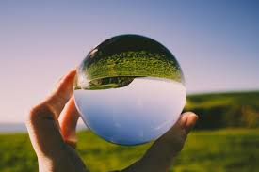
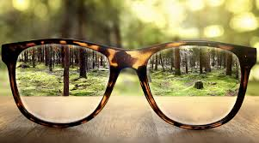
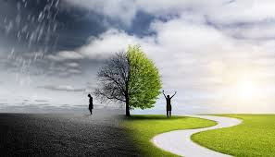
Perspective Perspective shapes how we interpret experiences, influences our emotions, and affects our overall outlook on life. The Role of Perspective in Gratitude: Scarcity vs. Abundance Mindset Reframing Experiences

Slide 6
Let’s have some fun!

Slide 7
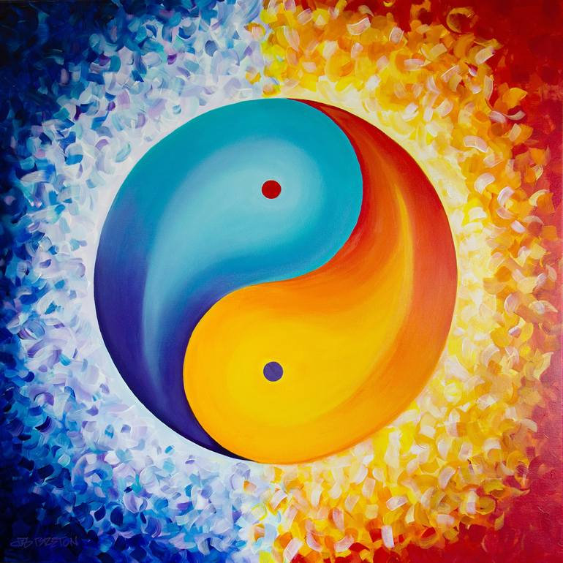
Balancing Gratitude & Realism
Gratitude does not mean ignoring problems. It allows for both acknowledging difficulties and finding appreciation where possible.
A balanced perspective integrates gratitude without invalidating real struggles.

Slide 8
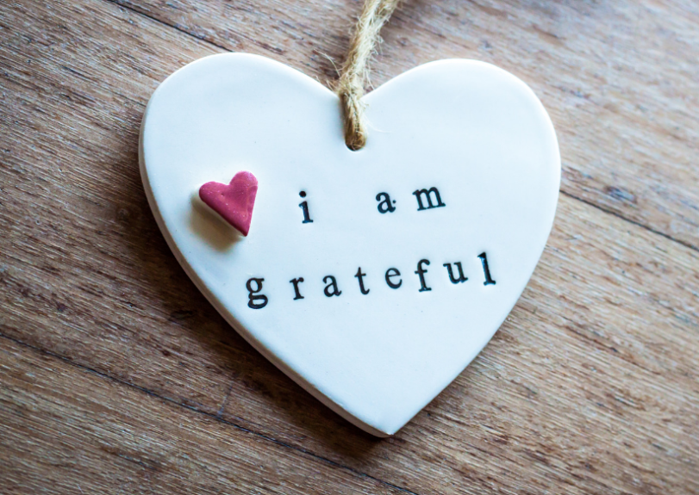
Change the Game NOW
Commit to beginning some type of gratitude practice starting NOW!
Mix it up until you find your vibe!
Tell someone you care about how grateful you are for them TODAY and WHY!
Ask yourself if you are carrying around a negative perspective. If the answer is yes, allow yourself to explore a new, more positive perspective.

Slide 9
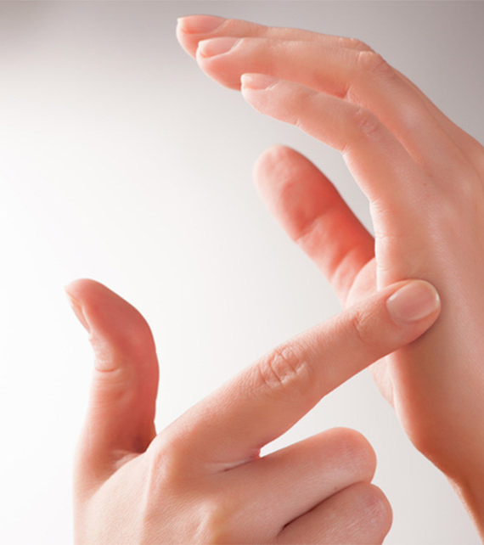
EFT Tapping

