Slide 1
Cozy Gaming
Gratitude and Wellness Through the Lens of Video Games
Nathan Low & May Sullivan Low

Slide 2
Tell us your fav game
Notes:
Create a word cloud and display it

Slide 3
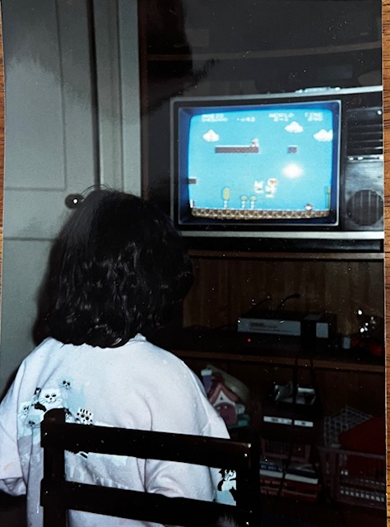
Notes:
Intersectionality - Different parts of a person’s identity can overlap and create unique experiences of privilege and oppression.
We all have a unique identity.
Gamer ( Nathan)
Parent ( May)
Australian (Nathan)
American ( May)
CisHet White Millenial ( May)
SIngle Mom (May)
Prep School Alum (Nathan)
Bipolar Type 1 (Nathan)
Lived Experience (Nathan)
Soccer Coach (May)
DMH Social Work Intern / Grad Student ( May)
Software Engineer ( Nathan)
Advocate ( May)
Ally (Nathan)

Slide 4
Introduction
1. Show how video games could promote wellness and happy feelings by using flow or inducing a cozy atmosphere.
2. Discuss how some game developers have used research and a strengths based approach to celebrate neurodiversity and to destigmatize mental health conditions.
3. To meet like-minded people who enjoy gaming and discuss gaming events.
Notes:
1. Show how video games could promote wellness and happy feelings by using flow or inducing a cozy atmosphere.
2. Discuss how some game developers have used research and a strengths based approach to celebrate neurodiversity and to destigmatize mental health conditions.
3. To meet like-minded people who enjoy gaming and discuss gaming events.

Slide 5
What are cozy games?
Cozy games are games that are relaxing and non-violent, and often involve activities such as growing plants, fishing, and caring for other characters.
Caring for other characters includes activities like sending letters, looking after pets and farm animals, giving gifts to or preparing meals for other characters.
Cozy gaming can be a coping method for anxiety and stress.
Notes:
Cozy games are games that are relaxing and non-violent, and often involve activities such as growing plants, fishing, and caring for other characters.
Caring for other characters includes activities like sending letters, looking after pets and farm animals, giving gifts to or preparing meals for other characters.
Cozy gaming can be a coping method for anxiety and stress.

Slide 6
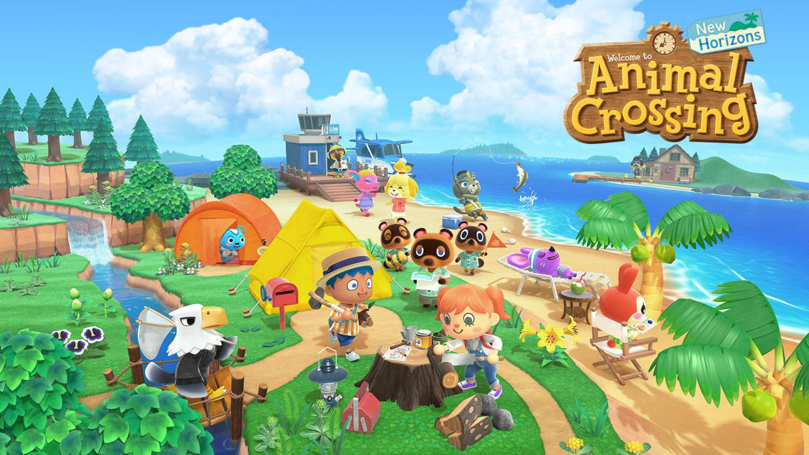
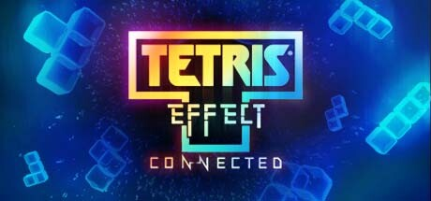
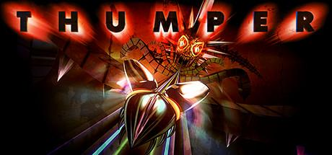
Different types of cozy games
Community Building/Sim Games: Games like this allow you build and cultivate your own areas and characters, and interact with other wholesome characters in a relaxed way. These games are great at providing players with a sense of autonomy, self-expression, community and satisfying basic psychological needs.
Puzzle Games: Games like this allow you to organize shapes and pieces to work together in a soothing way, allowing yourself to become absorbed in creating order from chaos, and particularly good at inducing flow.
Rhythm Games: Press buttons in time with sights and sounds of a game, usually with bombastic audio and visual effects. Also effective at inducing flow.
Visual Novels: Games like this allow you to interact with other characters in a safe simulated environment, and usually tackle social issues in a way to help the player understand both sides of the issue.
Notes:
Community Building/Sim Games: Games like this allow you build and cultivate your own areas and characters, and interact with other wholesome characters in a relaxed way. These games are great at providing players with a sense of autonomy, self-expression, community and satisfying basic psychological needs.
Puzzle Games: Games like this allow you to organize shapes and pieces to work together in a soothing way, allowing yourself to become absorbed in creating order from chaos, and particularly good at inducing flow.
Rhythm Games: Press buttons in time with sights and sounds of a game, usually with bombastic audio and visual effects. Also effective at inducing flow.
Visual Novels: Games like this allow you to interact with other characters in a safe simulated environment, and usually tackle social issues in a way to help the player understand both sides of the issue.

Slide 7
Community Building Games
Excellent for providing players with a sense of autonomy, community and satisfying basic psychological needs.

Slide 8
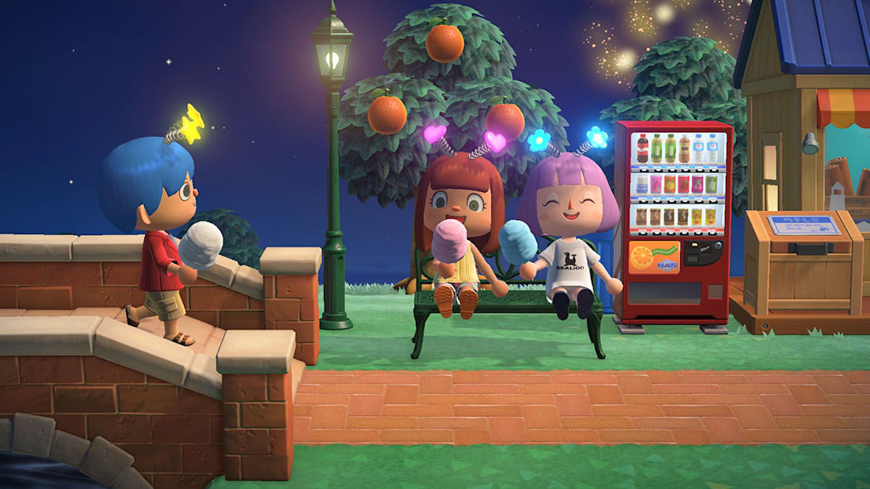
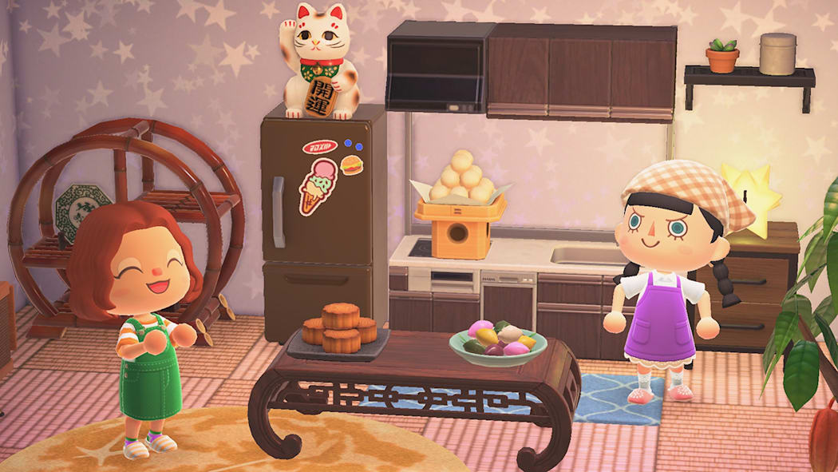
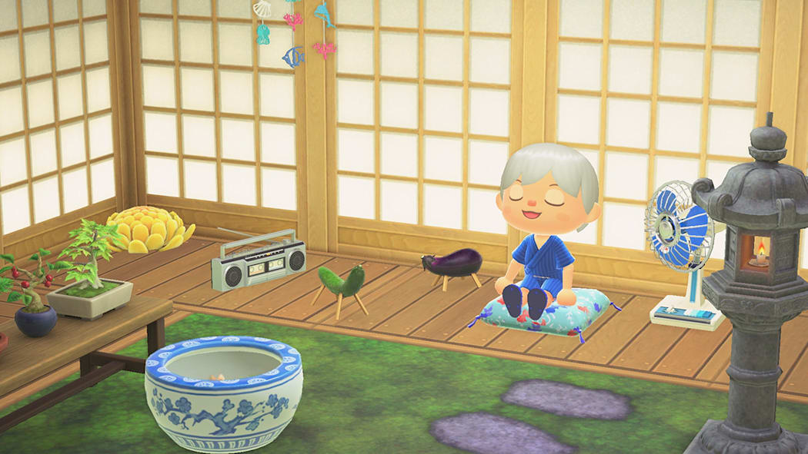
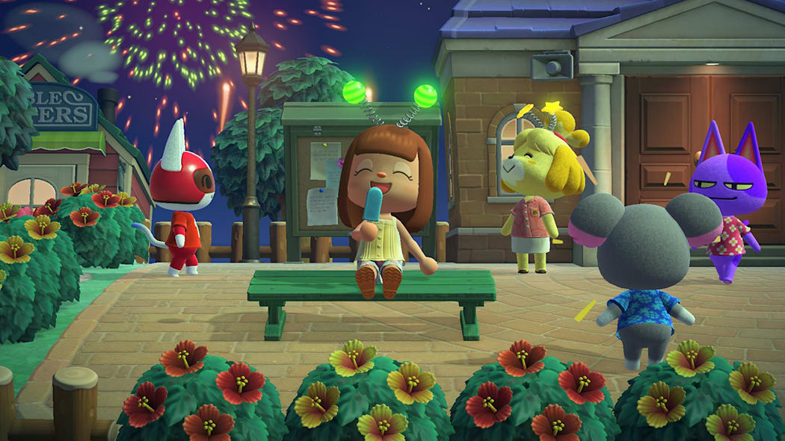
Animal Crossing
Probably the cozy game of 2020, and still going strong!
Travel to your own personal island and decorate it the way you want while making money doing low stress tasks like picking fruit and digging up fossils.
Great for people that like to take things slowly, as new items and fashions appear daily.
Get to know your neighborhood animal friends and send them gifts and letters and you’ll get surprises in return.
Proven to help with connecting with other people, and provide a sense of autonomy, especially during times where things seem out of control, such as the COVID-19 years.
Animal Crossing and COVID-19: A Qualitative Study Examining How Video Games Satisfy Basic Psychological Needs During the Pandemic https://pmc.ncbi.nlm.nih.gov/articles/PMC9022176/
Notes:
Probably the cozy game of 2020, and still going strong!
Travel to your own personal island and decorate it the way you want while making money doing low stress tasks like picking fruit and digging up fossils.
Great for people that like to take things slowly, as new items and fashions appear daily.
Get to know your neighborhood animal friends and send them gifts and letters and you’ll get surprises in return.
Proven to help with connecting with other people, and provide a sense of autonomy, especially during times where things seem out of control, such as the COVID-19 years.

Slide 9
Animal Crossing
Probably the cozy game of 2020, and still going strong!
Travel to your own personal island and decorate it the way you want while making money doing low stress tasks like picking fruit and digging up fossils.
Great for people that like to take things slowly, as new items and fashions appear daily.
Get to know your neighborhood animal friends and send them gifts and letters and you’ll get surprises in return.
Proven to help with connecting with other people, and provide a sense of autonomy, especially during times where things seem out of control, such as the COVID-19 years.
Animal Crossing and COVID-19: A Qualitative Study Examining How Video Games Satisfy Basic Psychological Needs During the Pandemic https://pmc.ncbi.nlm.nih.gov/articles/PMC9022176/

Slide 10
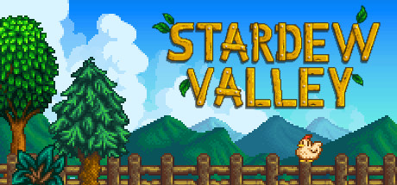
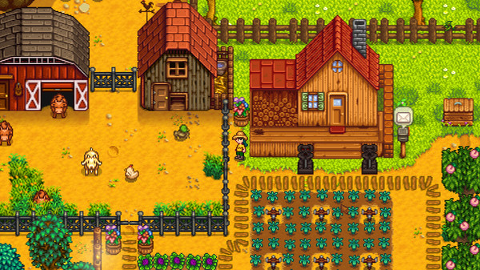
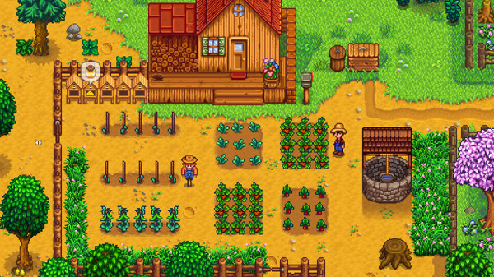
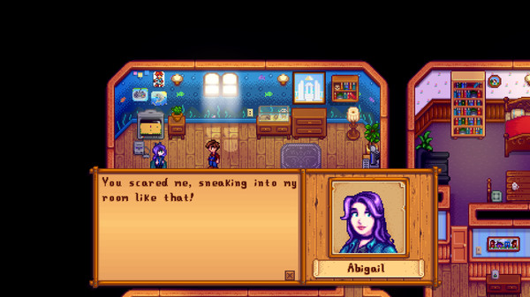
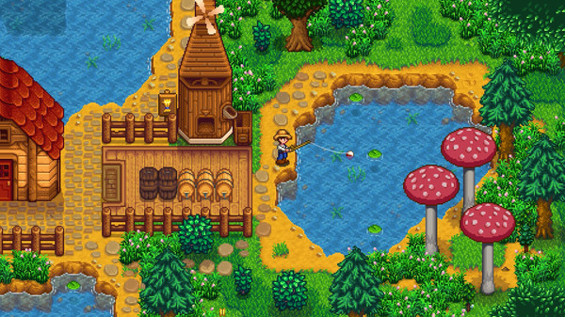
Stardew Valley
Run your own farm, and build a the community around it back to its former glory.
Plenty to see and do: Explore a vast cave, go fishing, customize your character, home and farm, learn to cook.
More than 30 unique characters to meet, and it’s possible to marry 12 of them.
Great for people that want to try to live the farming life in a relaxed atmosphere.
Notes:
Run your own farm, and build a the community around it back to its former glory.
Plenty to see and do: Explore a vast cave, go fishing, customize your character, home and farm, learn to cook.
More than 30 unique characters to meet, and it’s possible to marry 12 of them.
Great for people that want to try to live the farming life in a relaxed atmosphere.

Slide 11
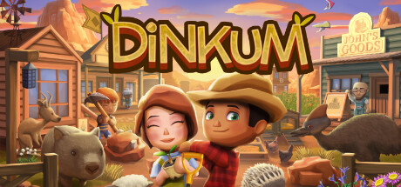
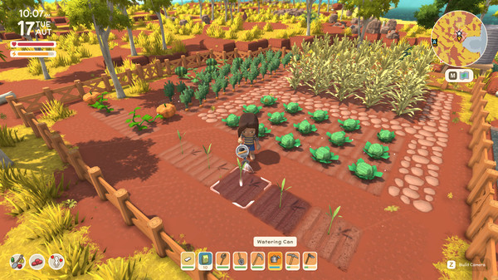
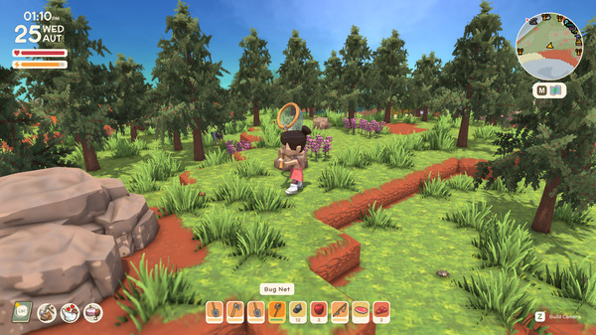
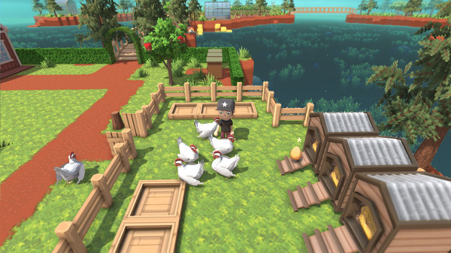
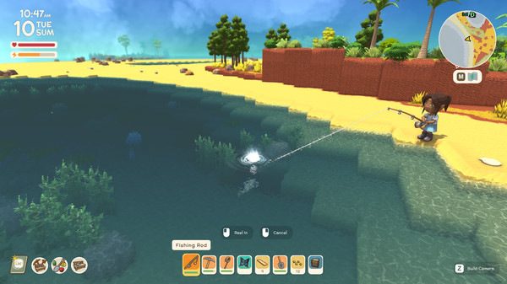
Dinkum
A cross between Animal Crossing and Stardew Valley, with an Australian theme.
Build up a farm and town and customize everything to be the way you want.
There’s relaxing ways to earn money as well, like bug catching, fishing and looking after animals like cows, chickens and giant wombats.
Good if you’ve tried the previous two and want something new.
Notes:
A cross between Animal Crossing and Stardew Valley, with an Australian theme.
Build up a farm and town and customize everything to be the way you want.
There’s relaxing ways to earn money as well, like bug catching, fishing and looking after animals like cows, chickens and giant wombats.
Good if you’ve tried the previous two and want something new.

Slide 12
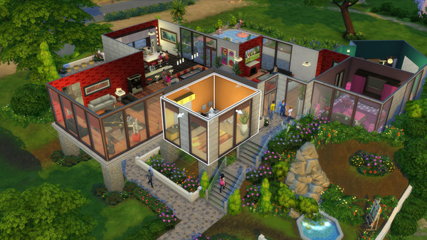
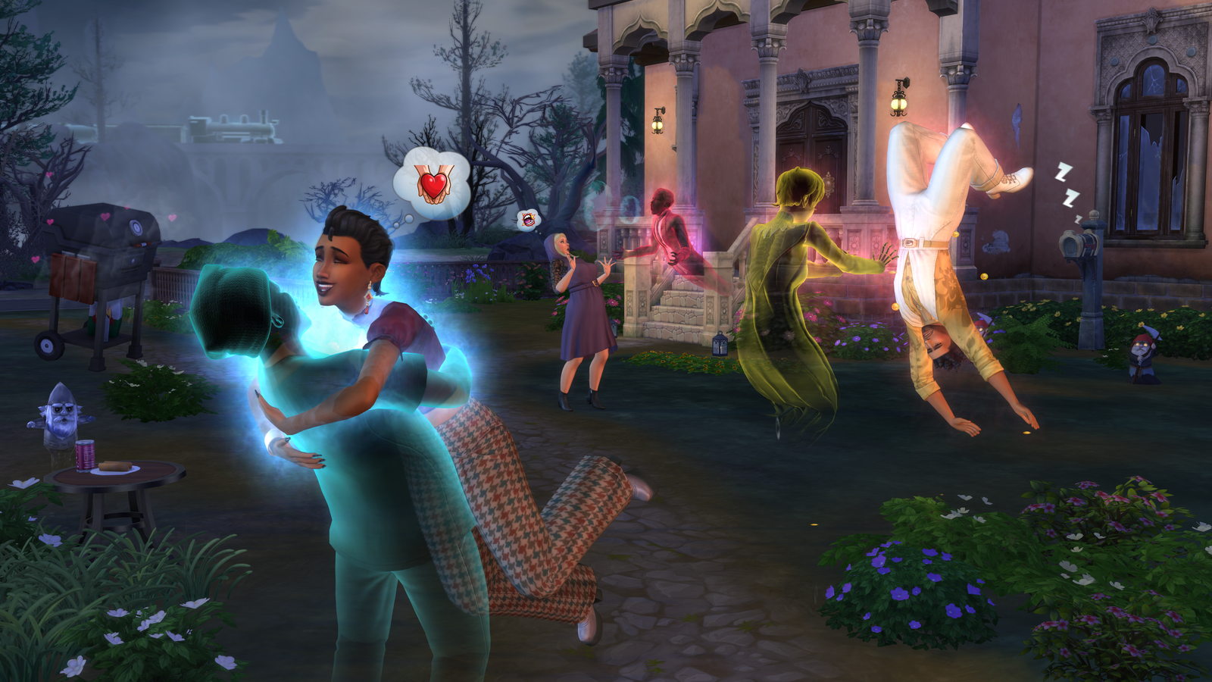
The Sims
Design your dream home.
Create families, neighbors and see how they interact together.
See how the choices and quirks you select for your sims affects their lives and the lives of those around them.
Good for people who want to try working with different family or friend dynamics.
Proven to be have potential as a engaging and flexible approach to providing therapeutic treatment for maltreated youth.
Utilising a computer game as a therapeutic intervention for youth in residential care: Some preliminary findings on use and acceptability - ScienceDirect
Notes:
Design your dream home.
Create families, neighbors and see how they interact together.
See how the choices and quirks you select for your sims affects their lives and the lives of those around them.
Good for people who want to try working with different family or friend dynamics.
Proven to be have potential as a engaging and flexible approach to providing therapeutic treatment for maltreated youth.

Slide 13
Cozy gaming and online communities
Since the pandemic ended, the r/cozygamers subreddit has grown to over 246,000 members, and many similar subreddits have opened since.
These groups are full of people from diverse backgrounds, and cozy games are played by hundreds of thousands of people around the world.
Groups like these are all about spreading positivity and gratefulness. You can appreciate other gamers art and designs, and share your own and get feedback
https://www.rollingstone.com/culture/rs-gaming/what-are-cozy-games-online-community-1235032742/
Notes:
Since the pandemic ended, the r/cozygamers subreddit has grown to over 246,000 members, and many similar subreddits have opened since.
These groups are full of people from diverse backgrounds, and cozy games are played by hundreds of thousands of people around the world.
Groups like these are all about spreading positivity and gratefulness. You can appreciate other gamers art and designs, and share your own and get feedback

Slide 14
Cozy gaming and online communities
Reddit groups:
r/CozyGamers - As mentioned previously
r/patientgamers - Usually gamers that play older games on sale, usually pretty chill to talk to
r/cozygames – A less popular version of r/CozyGamers
Pretty much any game you’re into will have its own subreddit
TikTok:
TikTok has a Cozy Games Topic here.
Notes:
Reddit groups:
r/CozyGamers - As mentioned previously
r/patientgamers - Usually gamers that play older games on sale, usually pretty chill to talk to
r/cozygames – A less popular version of r/CozyGamers
Pretty much any game you’re into will have its own subreddit
TikTok:
TikTok has a Cozy Games Topic here.

Slide 15
Cozy gaming and online communities
Steam Groups:
https://steamcommunity.com/groups/_wholesomegames - Wholesome games group, similar to cozy games, updated often and with over 7.8K+ members
https://steamcommunity.com/groups/reddit-cozy-gamers – The Steam group for r/CozyGamers – Over 380+ members at time of writing
Facebook groups:
https://www.facebook.com/groups/cozygamer/ — A facebook group that talks about cozy games. 380K+ members. Also has its own discord server
Notes:
Steam Groups:
https://steamcommunity.com/groups/_wholesomegames - Wholesome games group, similar to cozy games, updated often and with over 7.8K+ members
https://steamcommunity.com/groups/reddit-cozy-gamers – The Steam group for r/CozyGamers – Over 380+ members at time of writing
Facebook groups:
https://www.facebook.com/groups/cozygamer/ — A facebook group that talks about cozy games. 380K+ members. Also has its own discord server

Slide 16
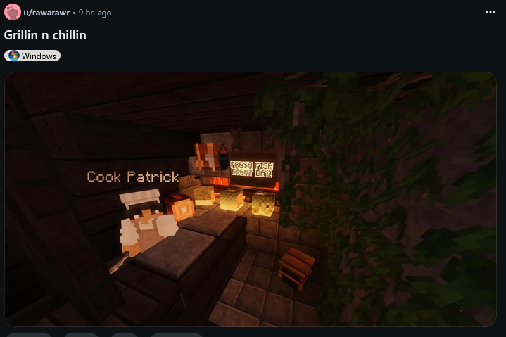
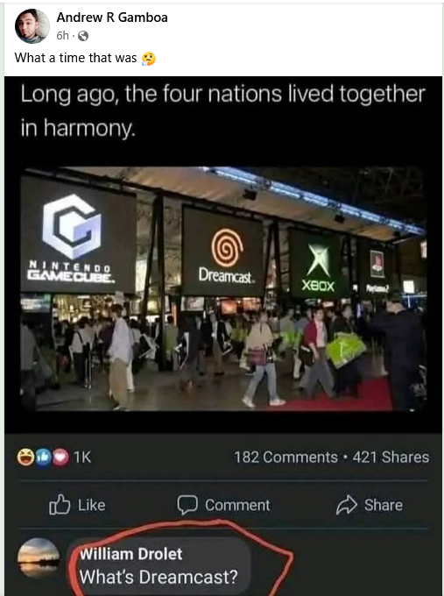
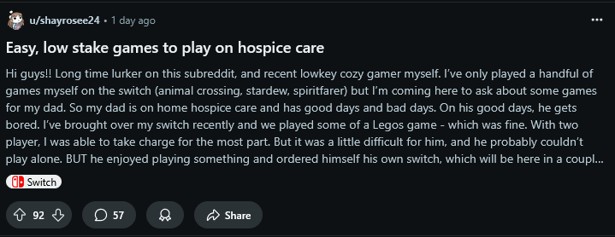
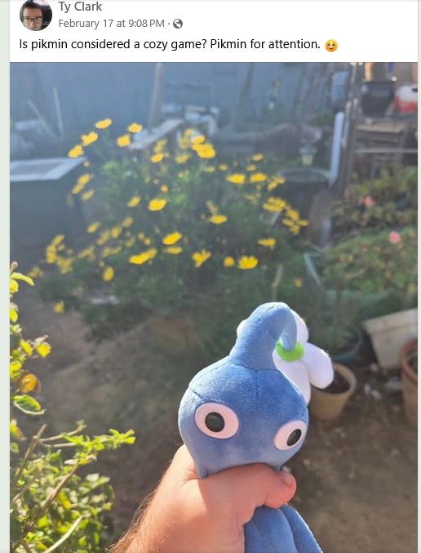
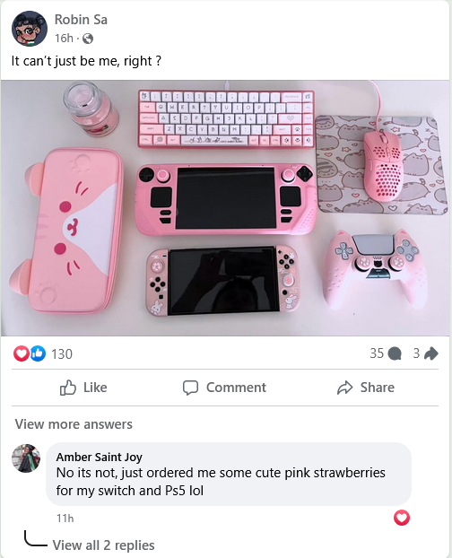
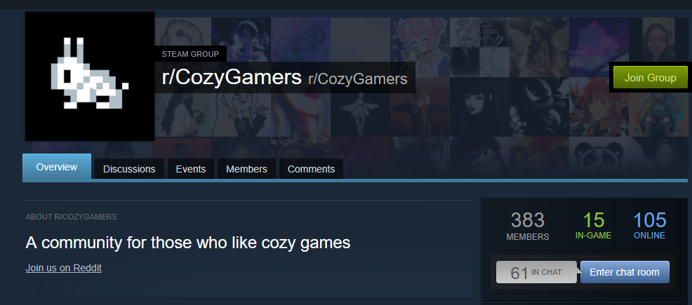
Cozy Game Online Community Examples

Slide 17
Gaming Community - PAX EAST
PAX East is a celebration of gaming and gaming culture featuring thought-provoking panels, a massive expo hall filled with the best publishers and studios!
When gamers meet in person after primarily interacting online, it can feel like a surreal experience, often filled with a mix of excitement, familiarity, and a bit of awkwardness.
Notes:
PAX East is a celebration of gaming and gaming culture featuring thought-provoking panels, a massive expo hall filled with the best publishers and studios!
When gamers meet in person after primarily interacting online, it can feel like a surreal experience, often filled with a mix of excitement, familiarity, and a bit of awkwardness.

Slide 18
Gaming Community - PAX EAST
Meeting people at PAX East:
There’s a great service called LFG (Looking For Group) that Pax East offers where you choose a board game you want to play and offer to play it with other people. You can look for other people that are looking for a group as well.
There’s lots of great ways to meet people at Pax.
Talk to others in line for games you’re interested in.
Bring a switch or 3ds to play video games with others.
Bring a small quick card game to play in line.
Talk to the indie devs at the indie game booths (Usually they are happy to talk about what they’ve been working on).
Wear a shirt with a game you like and see if anyone else starts up a conversation with you.
If you’re brave, sign up for a D & D session where you can act out character with 5-6 others.
Notes:
Meeting people at PAX East:
There’s a great service called LFG (Looking For Group) that Pax East offers where you choose a board game you want to play and offer to play it with other people. You can look for other people that are looking for a group as well.
There’s lots of great ways to meet people at Pax.
Talk to others in line for games you’re interested in.
Bring a switch or 3ds to play video games with others.
Bring a small quick card game to play in line.
Talk to the indie devs at the indie game booths (Usually they are happy to talk about what they’ve been working on).
Wear a shirt with a game you like and see if anyone else starts up a conversation with you.
If you’re brave, sign up for a D & D session where you can act out character with 5-6 others.

Slide 19
Gaming Community - Other Upcoming events
Pintastic Pinball - April 10th - 13th - https://pintasticnewengland.com/ - Lots of pinball machines.
Fan Expo Boston - August 8th - 10th - https://fanexpohq.com/fanexpoboston/ - Lots of comic, cosplay and gaming people to meet with.
RetroExpo - April 5th - https://retroxpos.com/ - Retro games, comics, etc.
AnalogFest - June 1st - https://www.facebook.com/events/532713732459431 - Lots of retro games
Notes:
Pintastic Pinball - April 10th - 13th - https://pintasticnewengland.com/ - Lots of pinball machines.
Fan Expo Boston - August 8th - 10th - https://fanexpohq.com/fanexpoboston/ - Lots of comic, cosplay and gaming people to meet with.
RetroExpo - April 5th - https://retroxpos.com/ - Retro games, comics, etc.
AnalogFest - June 1st - https://www.facebook.com/events/532713732459431 - Lots of retro games

Slide 20
Gaming Community - Local Stores
Materia - Worcester - Arcade and video game store.
Game Underground - Waltham - Usually hosts game nights for Smash Bros and Street Fighter.
Replay’d - Allston - Lots of retro games. Mostly buying and selling.
Versus - Boston - Tekken fighting game nights, lots of arcade games.
Bowser’s Basement - Taunton, Plymouth - Cool vibe, mostly sales and can find some retro treasures.
Roxy’s Arcade - Cambridge - Secret arcade in a cheese sandwich shop.
Notes:
Materia - Worcester - Arcade and video game store.
Game Underground - Waltham - Usually hosts game nights for Smash Bros and Street Fighter.
Replay’d - Allston - Lots of retro games. Mostly buying and selling.
Versus - Boston - Tekken fighting game nights, lots of arcade games.
Bowser’s Basement - Taunton, Plymouth - Cool vibe, mostly sales and can find some retro treasures.
Roxy’s Arcade - Cambridge - Secret arcade in a cheese sandwich shop.

Slide 21
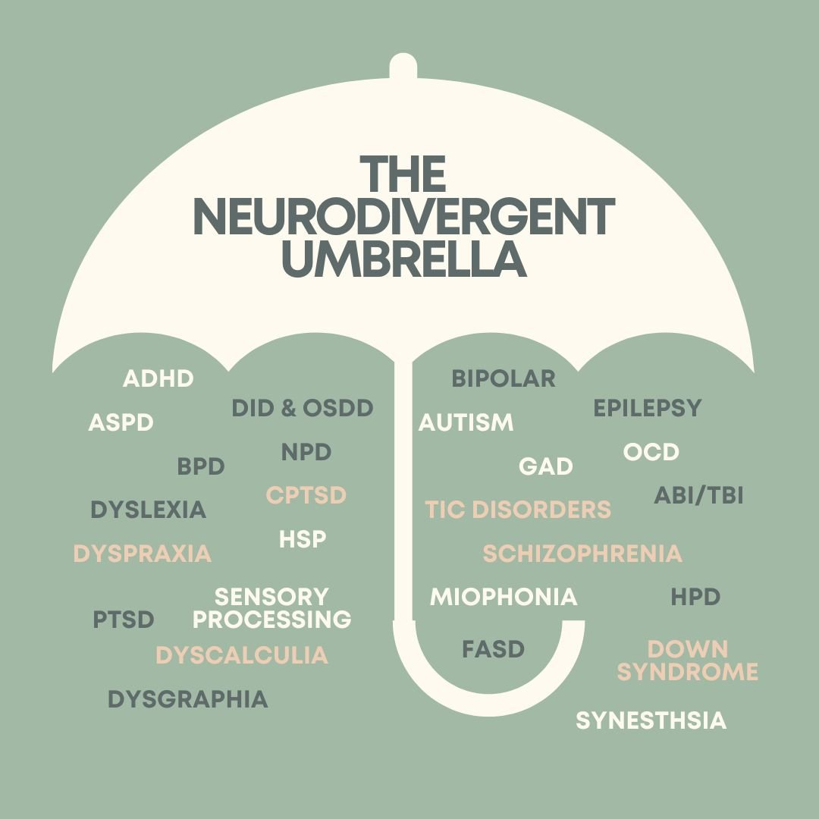
Neurodivercity vs. Neurodivergence
Neurodiversity: Celebrate that all brains have variations.
Neurodivergence: Some brains are different from what’s considered “typical”.
source: https://osf.io/preprints/metaarxiv/k7a9p/
website: https://www.aaha.org/newstat/publications/the-secret-sauce-strengths-of-the-neurodivergent-workforce-and-communication-tips-to-optimize-them/
Notes:
Neurodiversity: Celebrate that all brains have variations.
Neurodivergence: Some brains are different from what’s considered “typical”.

Slide 22
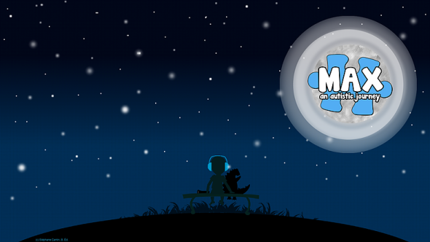
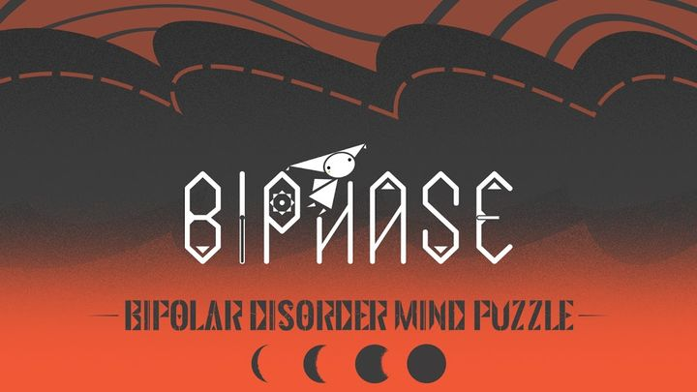
Approaching Neurodiversity & Mental Health in Gaming - Promote Empathy & Awareness
Anxiety/Depression/Dissociative Disorder
Autism /ADHD
Bipolar
Schizophrenia /Psychosis
Notes:
The protagonist of NITW is Mae Borowski, a 20 year old cisgender cat who returns to her hometown Possum Springs after dropping out of college with no real plans for the future.
During the game, Mae battles anxiety, depression and dissociative disorder as she searaches for meaning in her hometown in middle America, which faces economic hardships.
Though tackling serious subject matter, the game is quirky and fun with Mae bantering with old friends and keeping a journal that her therapist recommended she do.
2. Max is a 10 year old cisgender male who loves dinosaurs, monsters and who also has Autism and ADHD. The retro style RPG is filled with mini games and Max’s frustrations are represented by various beasts. The game developer is the father of a child who has autism but does not have autism himself.
3. Biphase was developed by a group of college students with support from the DBSA. Some of the game’s profits go to the DBSA. The goal of the game is to promote empathy and awareness about bipolar. In the puzzle game, red represents mania while black represents depression.
4. In Hellblade you play Senua, a 25 cisgender Celtic woman traversing through modern day Scotland to save the soul of her dead lover Dillon. Senua is plagued by schizophrenia which results in her psychosis which she refers to as “The Darkness”. The game developers worked with a team of clinicians, including a neuroscientist and people with lived experience of schizophrenia to try to accurately represent schizophrenia and destigmatize the conditioin. Some clinicians have played the VR version in an attempt to better understand their patients experiencing psychosis. The game has received over half a dozen awards.

Slide 23
Games and Flow
Flow, as famously described and investigated by Hungarian-American psychologist Mihaly Csikszentmihalyi, is a mental state characterized by deep absorption during challenging activities.
Studies have shown that getting into a state of flow can have therapeutic effects on anxiety and depression.
Csikszentmihalyi, Mihaly. (2009). Flow: The psychology of optimal experience. Harper & Row.
Khoshnoud, S., Alvarez Igarzábal, F., & Wittmann, M. (2020). Peripheral-physiological and neural correlates of the flow experience while playing video games: a comprehensive review. PeerJ, 8, e10520.
Notes:
muh·hay·lee chik·sent·mee·hai·ee Flow, as famously described and investigated by Hungarian-American psychologist Mihaly Csikszentmihalyi, is a mental state characterized by deep absorption during challenging activities.
Studies have shown that getting into a state of flow can have therapeutic effects on anxiety and depression.

Slide 24
Games and Flow
How is a state of flow induced?
Flow happens at a point of equilibrium between frustration and boredom. If an activity provides a level of challenge that is too low relative to the skill level of the person, one becomes bored. If the challenge is too high relative to the individual’s skill level, one becomes frustrated. The flow state sets in when the level of challenge of the activity meets the skill level of the person.
In this sense, flow is related to what we call "fun".
Puzzle Games and rhythm games specialize in inducing a flow state.
Notes:
How is a state of flow induced?
Flow happens at a point of equilibrium between frustration and boredom. If an activity provides a level of challenge that is too low relative to the skill level of the person, one becomes bored. If the challenge is too high relative to the individual’s skill level, one becomes frustrated. The flow state sets in when the level of challenge of the activity meets the skill level of the person.
In this sense, flow is related to what we call "fun".
Puzzle Games and rhythm games specialize in inducing a flow state.

Slide 25
Puzzle and Rhythm Games
Great for inducing a state of flow.

Slide 26
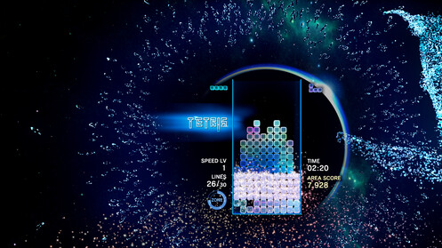
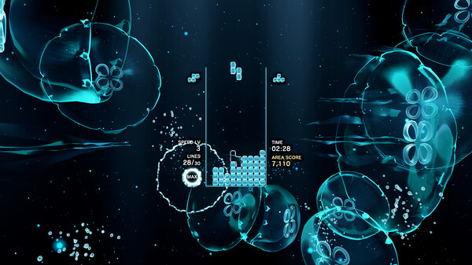
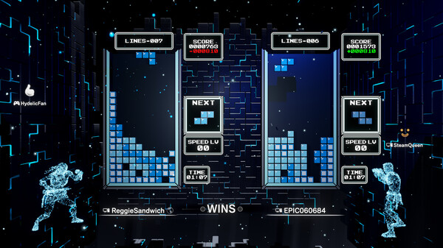
Tetris Effect
Tetris is a game where you move block shapes around to make lines and try to make order out of chaos.
This version of it has visual and audio effects designed to bring you into a state of flow.
Playing tetris has been shown to help with PTSD through the “Tetris Effect” or “Game Transfer Phenomena”.
Iyadurai, L; Blackwell, S E; Meiser-Stedman, R; Watson, P C; Bonsall, M B; Geddes, J R; Nobre, A C; Holmes, E A (2018). "Preventing intrusive memories after trauma via a brief intervention involving Tetris computer game play in the emergency department: a proof-of-concept randomized controlled trial". Molecular Psychiatry. 23 (3): 674–682. doi:10.1038/mp.2017.23. ISSN 1359-4184. PMC 5822451. PMID 28348380.
Notes:
Tetris is a game where you move block shapes around to make lines and try to make order out of chaos.
This version of it has visual and audio effects designed to bring you into a state of flow.
Playing tetris has been shown to help with PTSD through the “Tetris Effect” or “Game Transfer Phenomena”.

Slide 27
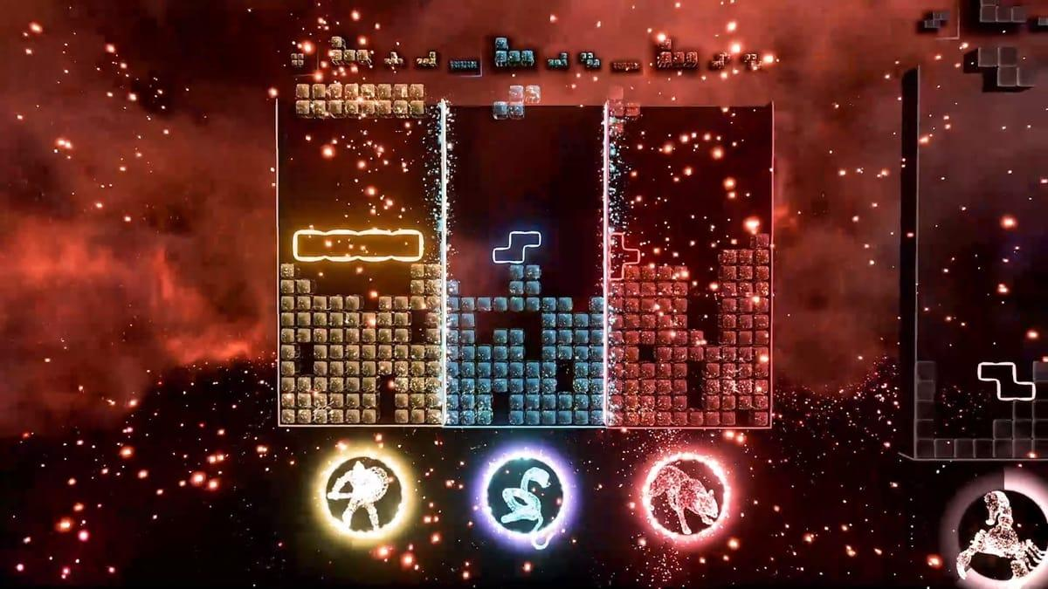
Tetris Effect Co-Op Showcase
Notes:
LIve Presentation - 3 volunteers will play this Co-op game and earn a prize.

Slide 28
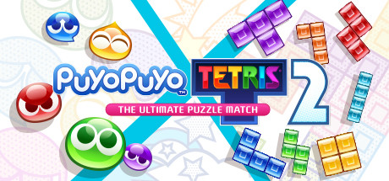
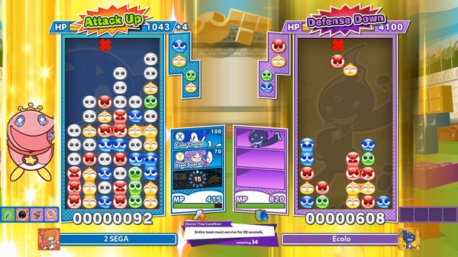
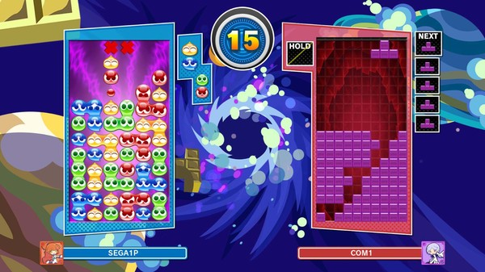
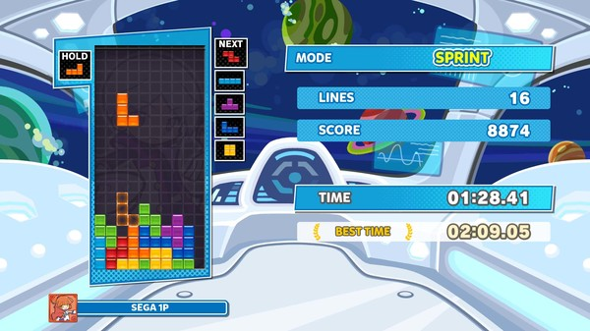
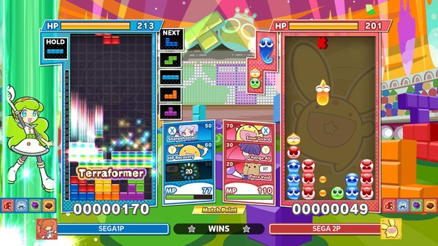
Puyo Puyo
Very similar to Tetris, the later versions of the game also include tetris as well.
Connect 4 or more blobs of the same color to clear the screen.
Set up chain reactions of blob clearing to send ghost blobs to your opponent.
Very easy to get into a flow state as you try to set up chain reaction after chain reaction.
Seeing a chain reaction of 5 or more is very satisfying.
Notes:
Very similar to Tetris, the later versions of the game also include tetris as well.
Connect 4 or more blobs of the same color to clear the screen.
Set up chain reactions of blob clearing to send ghost blobs to your opponent.
Very easy to get into a flow state as you try to set up chain reaction after chain reaction.
Seeing a chain reaction of 5 or more is very satisfying.

Slide 29
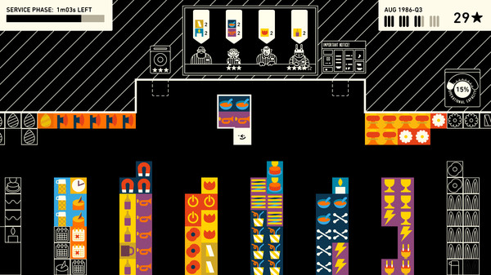
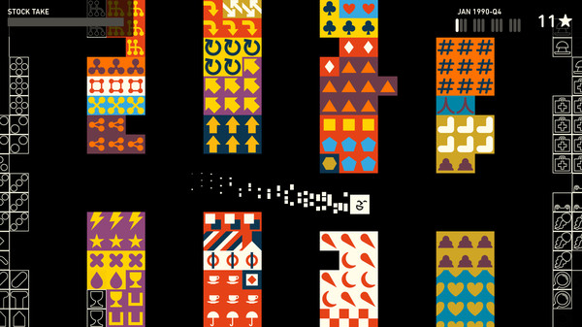
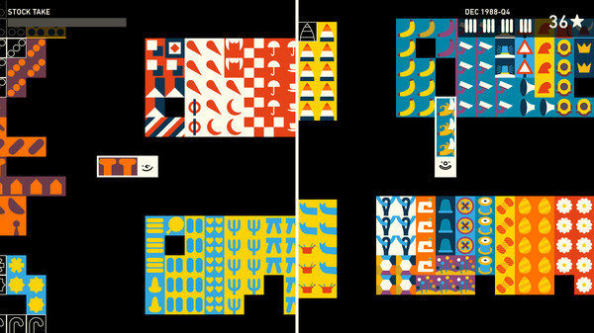
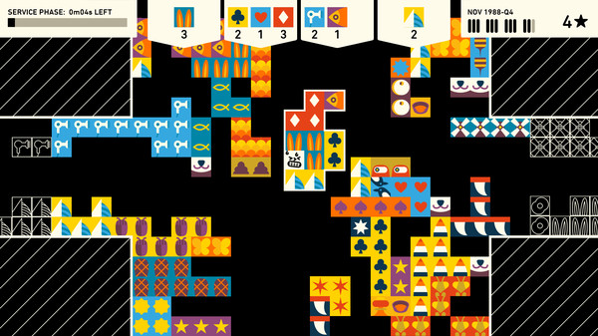
Wilmot’s Warehouse
Wilmot's Warehouse is a puzzle game about keeping a warehouse running in tip-top shape.
You play as Wilmot, a hard working warehouse employee tasked with pushing, sorting and stacking a variety of products.
You can organize the warehouse however you like, boots can go in a shoe section, a leather section or some sort of sorting only you can understand.
Usually relaxing, but the timed sections where you need to get things for customers can be stressful, or achieve a state of flow for those that get into the game.
Notes:
Wilmot's Warehouse is a puzzle game about keeping a warehouse running in tip-top shape.
You play as Wilmot, a hard working warehouse employee tasked with pushing, sorting and stacking a variety of products.
You can organize the warehouse however you like, boots can go in a shoe section, a leather section or some sort of sorting only you can understand.
Usually relaxing, but the timed sections where you need to get things for customers can be stressful, or achieve a state of flow for those that get into the game.

Slide 30
Thumper
Used in the VIRTUALTIMES project to study the effects of flow on anxiety and depression.
Very engrossing and intense game where you guide a racing beetle through rhythm courses where you must press the right button at the right time while visuals swirl all around you.
The project showed that players felt less self-rumination, depression and anxiety, induced by by the faster passing of time from in in a state of flow.
VIRTUALTIMES Project: https://brill.com/view/journals/time/9/4/article-p353_353.xml
Notes:
Used in the VIRTUALTIMES project to study the effects of flow on anxiety and depression.
Very engrossing and intense game where you guide a racing beetle through rhythm courses where you must press the right button at the right time while visuals swirl all around you.
The project showed that players felt less self-rumination, depression and anxiety, induced by by the faster passing of time from in in a state of flow.

Slide 31
Thumper
Used in the VIRTUALTIMES project to study the effects of flow on anxiety and depression.
Very engrossing and intense game where you guide a racing beetle through rhythm courses where you must press the right button at the right time while visuals swirl all around you.
The project showed that players felt less self-rumination, depression and anxiety, induced by by the faster passing of time from in in a state of flow.
VIRTUALTIMES Project: https://brill.com/view/journals/time/9/4/article-p353_353.xml
Notes:
Used in the VIRTUALTIMES project to study the effects of flow on anxiety and depression.
Very engrossing and intense game where you guide a racing beetle through rhythm courses where you must press the right button at the right time while visuals swirl all around you.
The project showed that players felt less self-rumination, depression and anxiety, induced by by the faster passing of time from in in a state of flow.

Slide 32
Upcoming/New Cozy Games
Good Coffee, Great Coffee - Make coffee for a coffee shop. Seems like you’ll need to research the recipes yourself, but a hit on the Cozy game Facebook group.
Stardew Valley 2 - A new Stardew Valley if you played the old one to completion.
inZOI - New “Sims” like game.
Unpacking - Unpack rooms and set them up the way you want.
Notes:
Good Coffee, Great Coffee - Make coffee for a coffee shop. Seems like you’ll need to research the recipes yourself, but a hit on the Cozy game Facebook group.
Stardew Valley 2 - A new Stardew Valley if you played the old one to completion.
inZOI - New “Sims” like game.
Unpacking - Unpack rooms and set them up the way you want.

Slide 33
Visual Novels
Great for exploring social topics, practicing social interaction and relating to others.

Slide 34
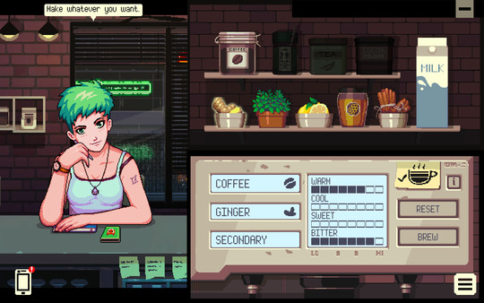
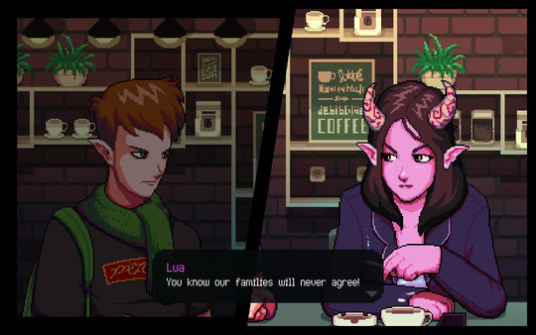
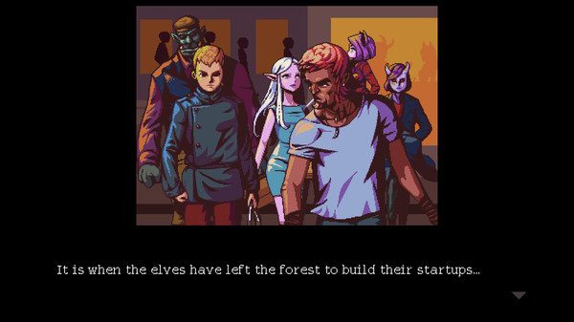
Coffee Talk
Coffee Talk is a game about listening to people’s problems and helping them by serving up a warm drink out of the ingredients you have in stock.
It is a game that depicts lives as humanly as possible, while having a cast that is more than just humans.
Papers have compared the game to a “Heterotopia” - a term philosopher Michel Foucault defines as concrete places that foster imagination and are separated from other places and spaces.
The game deals with topics such as racism, relationships, overcoming obstacles, and why conversations are so important.
(PDF) “Drown Your Troubles in Coffee”: Place, Heterotopia, and Immersion in the Coffee Talk Series
Notes:
het-uh-roh-TOH-pee-uh Coffee Talk is a game about listening to people’s problems and helping them by serving up a warm drink out of the ingredients you have in stock.
It is a game that depicts lives as humanly as possible, while having a cast that is more than just humans.
Papers have compared the game to a “Heterotopia” - a term philosopher Michel Foucault defines as concrete places that foster imagination and are separated from other places and spaces.
The game deals with topics such as racism, relationships, overcoming obstacles, and why conversations are so important.

Slide 35
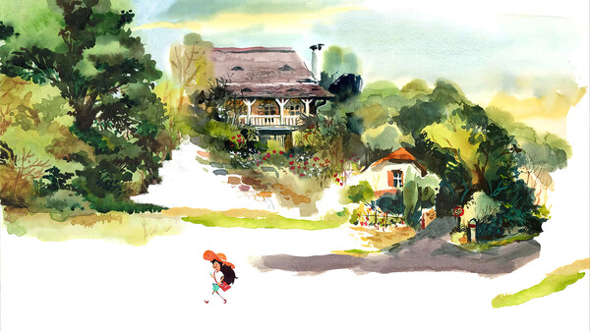
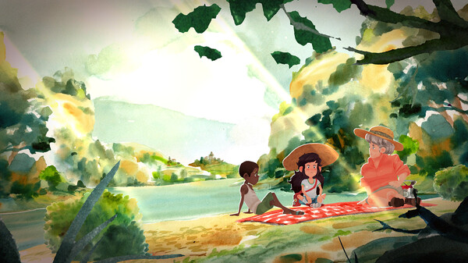
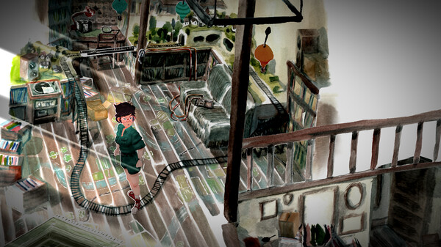
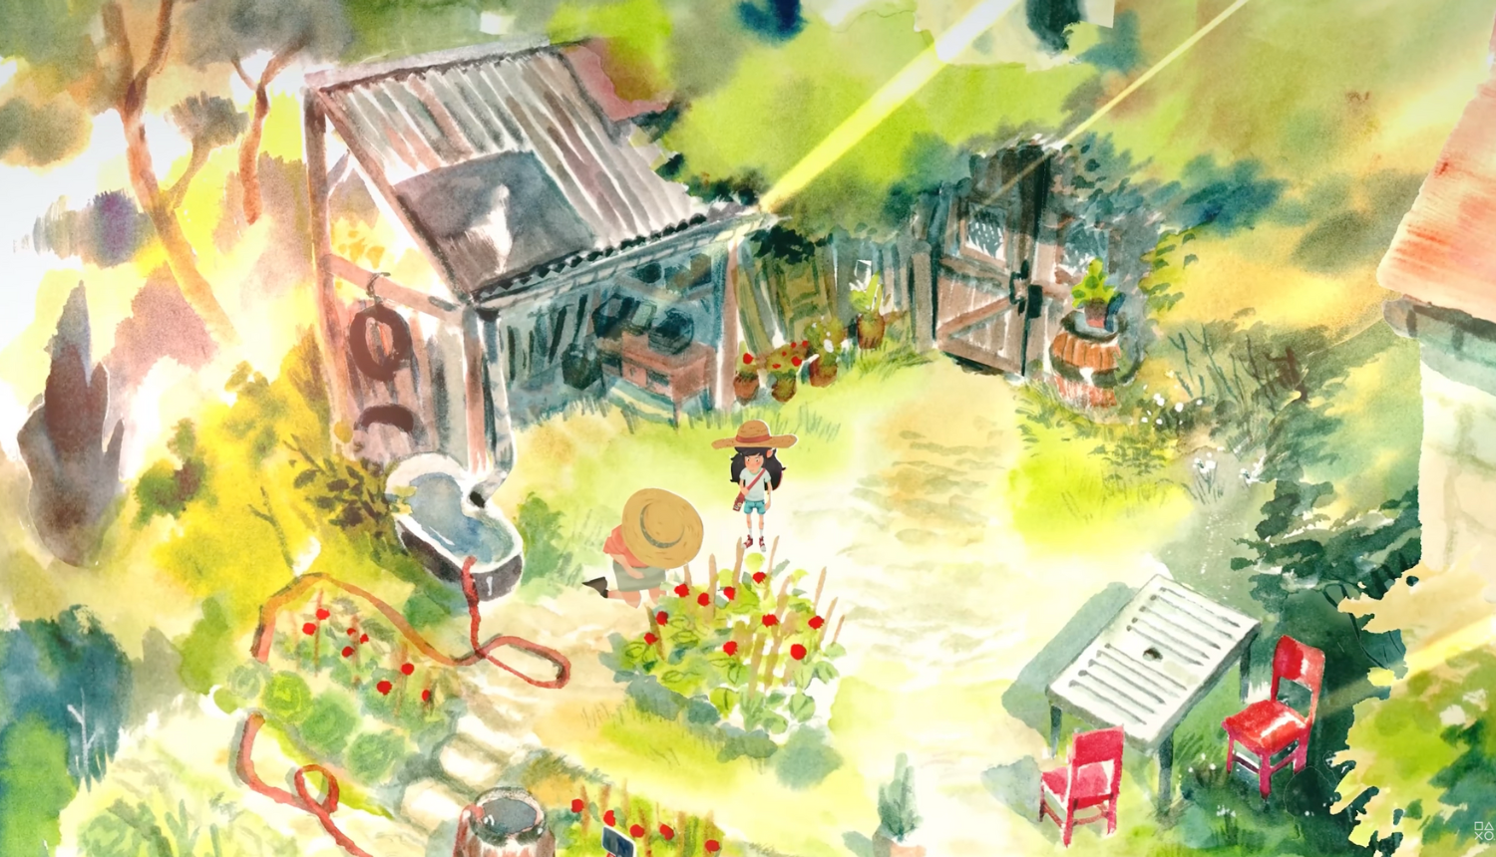
Dordogne
Immerse yourself in a unique narrative experience and explore the thousand summer colors of Dordogne as you revisit your childhood to uncover lost family secrets in this touching formative journey.
Explore a artfully rendered watercolor world as Mimi, a young lady revisiting her memories of vacations at her grandmother’s house in Dorgogne.
Deals with themes such as family secrets, grief, parental relations, and childhood adventure
The beginning can be a bit rough, where the daughter argues with her dad, but the game itself is very sweet.
Notes:
dor·dow·nyuh Immerse yourself in a unique narrative experience and explore the thousand summer colors of Dordogne as you revisit your childhood to uncover lost family secrets in this touching formative journey.
Explore a artfully rendered watercolor world as Mimi, a young lady revisiting her memories of vacations at her grandmother’s house in Dorgogne.
Deals with themes such as family secrets, grief, parental relations, and childhood adventure
The beginning can be a bit rough, where the daughter argues with her dad, but the game itself is very sweet.

Slide 36
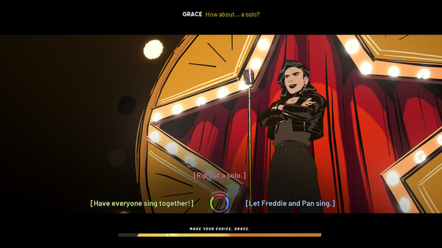
Stray Gods
Play as Grace in a world where Greek Gods live in hiding among us.
Change your fate as you draw friends, foes & lovers into song using your powers of musical persuasion to unravel the mystery of the Last Muse's death.
Features voice actors from both The Last of Us games, and a cast including Felicia Day.
A compelling story of hope, self-discovery, and forging your path.
Probably the most unique game on this list.
Notes:
Play as Grace in a world where Greek Gods live in hiding among us.
Change your fate as you draw friends, foes & lovers into song using your powers of musical persuasion to unravel the mystery of the Last Muse's death.
Features voice actors from both The Last of Us games, and a cast including Felicia Day.
A compelling story of hope, self-discovery, and forging your path.
Probably the most unique game on this list.

Slide 37
Stray Gods
Play as Grace in a world where Greek Gods live in hiding among us.
Change your fate as you draw friends, foes & lovers into song using your powers of musical persuasion to unravel the mystery of the Last Muse's death.
Features voice actors from both The Last of Us games, and a cast including Felicia Day.
A compelling story of hope, self-discovery, and forging your path.
Probably the most unique game on this list.

Slide 38
Conclusion
We hope you find that video gaming can have a positive effect on your well being and introduce you to more people.
We hope you will embrace neurodiversity in and outside of the gaming community and continue being an ally.
Make sure to go into social interactions with others with an open mind, and have fun!
Notes:
We hope you find that video gaming can have a positive effect on your well being and introduce you to more people.
We hope you will embrace neurodiversity in and outside of the gaming community and continue being an ally.
Make sure to go into social interactions with others with an open mind, and have fun!

